Slide 1
Zona euro, Portugal e ajustamento financeiro António Nogueira Leite
Abril de 2013

Slide 2
Índice
O euro: desafios
Sistema financeiro português e o ajustamento

Slide 3
Content
O euro: desafios
Sistema financeiro português e o ajustamento

Slide 4
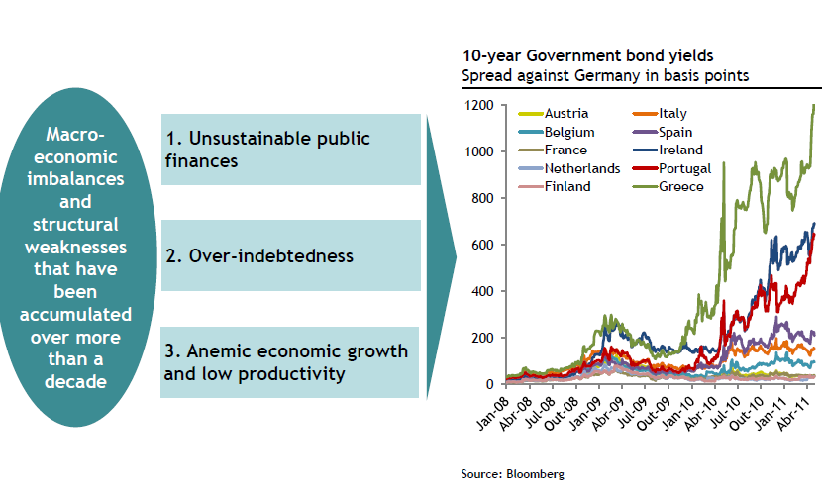
Não nos podemos esquecer que o “bail-out” de Abril de 2011 resultou de uma combinação de factores
Debt to GDP approaching 120%
Net foreign Debt above GDP
Average Growth of 1% in 2000-2010

Slide 5
Avaliação positiva nalguns aspectos chave mas permanece
Achievements
2011 2012
Challenges
2013 2014
Strong Compliance with the Program
6 successfull reviews; 1 incomplete
Key developments in all dimensions:
Correction of historical external imbalances (first trade surplus in decades)
Reduction of 6 p.p. in structural primary balance over 2 years
Put in motion widespread structural reforms
Privatization program
Return of the sovereign to the financial markets at na acceptable cost – Jan 23rd; 2.5Bn 5yr bonds at 4,89%
Focus on economic recovery and unemployment reduction
Complete comprehensive public expenditure review
Make the adjustment sustainable and keep social and political cohesion

Slide 6
Índice
O euro: desafios
Crescimento e ajustamento
Sistema financeiro português e o ajustamento

Slide 7
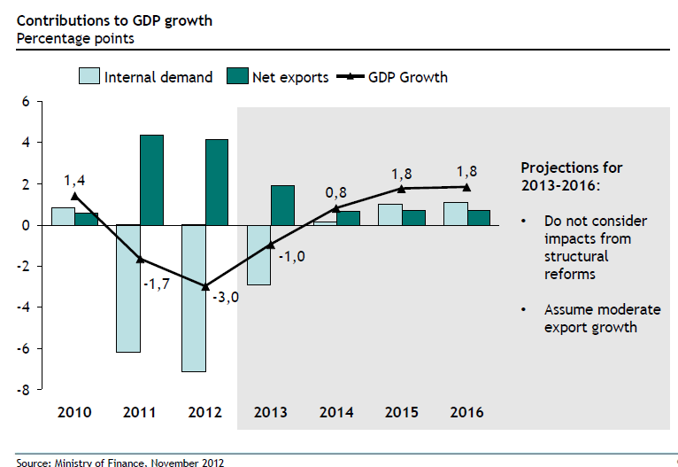
Exportações têm tido o maior contributo para a evolução do produto. Mas: -limites ao crescimento; -falta Investimento em aumentos de capacidade
Dados de Novembro de 2012

Slide 8
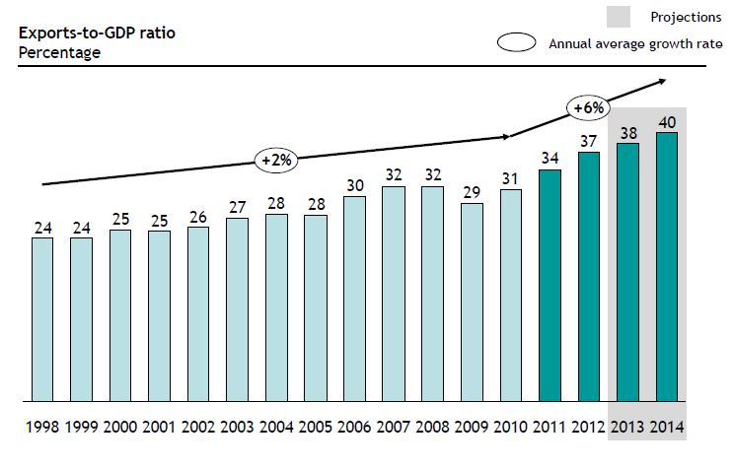
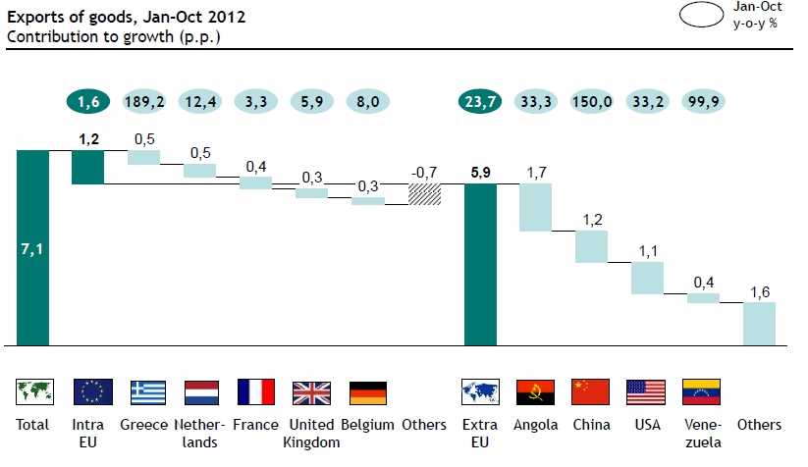
Tornar Portugal numa Export-led economy amplo consenso no objectivo; leva tempo e requer investimento
Ambitious export growth
Non EU markets provide the opportunities

Slide 9
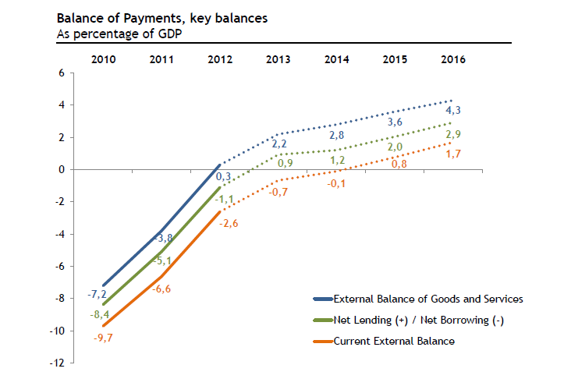
(pelo menos numa fase inicial) registou-se uma rápida evolução no desequilíbrio externo (fluxo)

Slide 10
Content
O euro: desafios
A (dificil) consolidação fiscal
Sistema financeiro português e o ajustamento

Slide 11
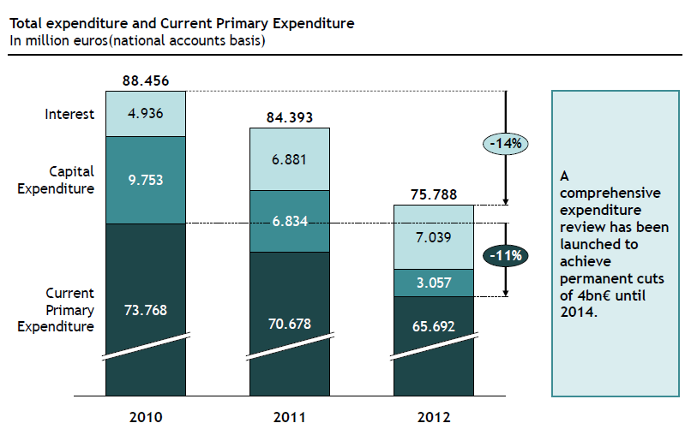
Redução importante da Despesa Pública (nem toda de modo sustentável)

Slide 12
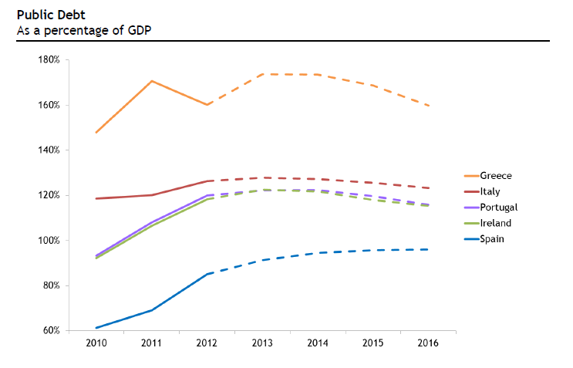
Divida Pública segue trajectória da Irlanda MF fala em P follower de Irl; felizmente Tesouro e IGCP aparentam estratégia própria

Slide 13
Content
O euro: desafios
Súmula da “narrativa” governamental
Sistema financeiro português e o ajustamento

Slide 14
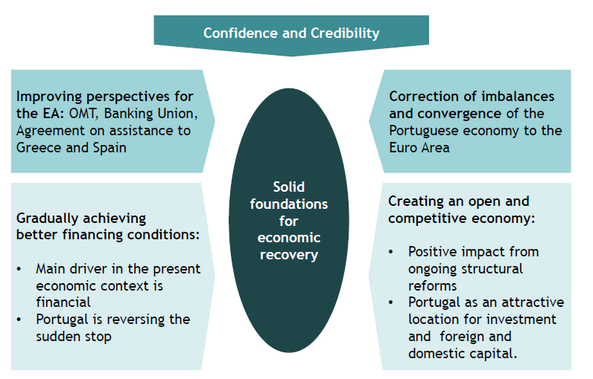
Portugal estará a criar as bases para o crescimento….
The performance so far, the new rules of sovereign debt intervention by the ECB, and improved conditions on debt repayment for Ireland and Portugal have led to a sustainable decrease of financing rates on the secondary markets allowing for =>
Portugal’s first medium term market financing of its Sovereign Debt since 2010 on January 23rd, 2013. Portugal placed €2.5 billion of 5 year Treasury bonds at a rate of 4.8%.

Slide 15
Content
O euro: desafios
Sistema financeiro português e o ajustamento

Slide 16
Portugal’s sovereign debt crisis (since 2010) ignited a vicious circle limiting the funding of domestic banks
Falling rating marks on the sovereign led to a decreasing rating of banks
Increasingly difficult access to wholesale markets
1
2
3
Increased ECB dependency
Sharp decline in the sources of funding

Slide 17
The bail out (April 2011) put additional constarints on banks
O plano de assistência financeira a Portugal, assinado em Abril de 2011 pelo Governo Português veio trazer exigências para o sistema bancário Português dedicando-lhe um dos 3 pilares...
Liquidez e ajuda para regresso aos mercados: reforço para 35 mil milhões de euros da Linha de Garantia do Estado às emissões de divida das Instituições de Crédito
Desalavancagem: convergência para o rácio de transformação de 120%
Capital: Core Tier 1 de 9% no final 2011 e de 10% no final 2012, para apoio ao seu cumprimento é criada dentro do Plano uma linha de Capitalização Pública de €12B
Funding and Capital Plan: obrigatoriedade em elaborar o FCP de médio e longo prazo tendo em vista o cumprimentos dos objetivos
Special On-site Inspections: realização de auditorias externas para validar informação sobre os ativos e solvabilidade dos bancos

Slide 18
EBA set new capital requirements for 2012, leading banks to raise capital.
EBA recommendation of Dec 2011 imposed tougher capital requirement on banks...
With the exception of BES all major Portuguese banks had to access the Government’s support fund of 12B (MillenniumBCP, CGD, BPI, Banif)
To compensate for the dowgrading of European sovereigns
For Portugal, EBA identified the need of €6,950M of extra capital for Portugal’s 4 largest banks:
CGD, BCP, BES e BPI
(...)
This was considered state aid by DGComp: negotiations with CGD, MillenniumBCP, BPI and Banif still underway to set remedial compensations

Slide 19
Banks were capitalized through a mix of new capital and CoCos, to be reimbursed in up to 5 years
Annual remuneration of CoCos: for CGD, Millennium and BPI
Interesr rate(%)
10.0
10.00
Annual step ups of 25 bps for the first 2 years and 50 bps afteerwards
+0.50
9.5
9.50
+0.50
9.0
9.00
8.75
+0.25
8.50
+0.25
0.0
2012
2013
2014
2015
2016
Fonte: Diário da Republica (03/07/2012); CGD information

Slide 20
Relative size of the state aid vis a vis European benchmarks
RWAs vs size of State Aid
aid/ RWA (%)
8
Recent European Examples
Portuguese Banks
6
5.8
5.4
5.2
4
4.2
3.9
3.7
3.4
Ø 4.0
2.9
2.8
2.4
CGD
2
0
BayernLB
Dexia
KBC
Commerzbank
Lloyds
ING
LBBW
BPI
BCP
CGD
Montante de ajuda (€B)
€10B
€6,4B
€7B
€8,2B
€19B¹
€10B
€5B
€1,3B
€3,0B
€1,65B
RWA (€B)
€173B
€153B
€178B
€222B
€558B¹
€343B
€178B
€25B
€55B
€69B
Fonte: Imprensa; Comissão Europeia

Slide 21
Propspects for Euribor are unhelpful for Portuguese Banks given their large mortgage portfolios (negative carry)

Slide 22
Economic prospects willcause banks to register substantial credit imparities in 2012 , 2013 and beyond
in 2012 banks registered imparities in line with those of 2011
Portugal in recession in 2012 and 2013
PIB Real (€B)
Cost-of-risk (%)¹
200
-3%
2,0
-4%
Bank A
165
165
160
162
159
155
153
150
1,5
Bank B
Bank C
100
1,0
Bank E
Bank D
50
0,5
0
0,0
2007
2008
2009
2010
2011
2012E
2013E
2007
2008
2009
2010
2011
1. Imparidades de crédito/ crédito total
Source: FMI; CGD

Slide 23
Financing the Economy
In spite of an adverse environment (legacy, prospects for euribor) banks are –for the moment—capitalized and have strong liquidity positions (deposits have remained stable, banks have been deleveraging in line with the adjustment program, and as of recently the system has reduced its ECB funding (3,5B returned in January alone);
Portugal still presents very high levels of credit financing (non financial companies are undercapitalized):
Small access to capital markets;
SMEs totally dependent on credit for financing.

Slide 24
Fraco recurso ao mercado de capitais
Capital Markets play a lesser role in corporate financing
Country | Index | Market Cap / GDP¹
Portugal | PSI-Geral | 27,50%
Spain | Madrid Stock Exchange Stock Index | 38,12%
Germany | Deutsche Borse AG Composite Index | 46,91%
France | CAC All-Share Index | 59,06%
UK | FTSE All-Share Index | 146,90%
USA | NYSE Composite Index | 112,16%
Source: Bloomberg; IMF
Market cap of December 2012 and GDP of 2011.

Slide 25
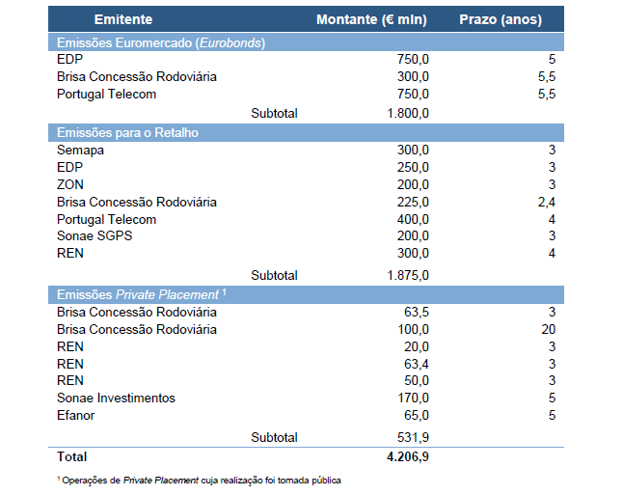
NFC desintermmediated funding 2012

Slide 26
Banks performed their first market operations
BES in Oct 2012
CGD in Nov 2012 (500 M 3 yr bonds) and January 2013

Slide 27
Strategic Challenges
Short to medium term

Slide 28
The starting point
Overcome Macroeconomic constraints
structural inbalances (leverage)
Negative growth and asset devaluation
difficult access of NFCs to bank financing and capital
Banks have been asked to help in reshaping the economy and its specialization
new companies in tradeable sectors
companies that face favorable market conditions
companies that have to reinvent themselves to have a chance to survive
Help improve NFCs financing
excessive reliance on bank credit
Credit to NFCs amounts to 210% of GDP (SMEs 105%)
constraints due to banks profitability challenges
incipient access to capital markets and scarcity of capital
stock market cap of 35% of GDP
risk capital and private equity firms with assets of less than 1,5% of GDP

Slide 29
Main Restrictions
Large expected imparities for 2013 (and to some extent for 2014 and beyond),
low euribor
Very large portfolio of mortgage credit (especially in CGD—32B—and Millennium, the 2 largest banks) with substancial negative carry [average spread below 100.p.p. for a current marginal cost of funding of at least 275 p.p. (LTRO))
Limits to the contribution of non-domestic markets

Slide 30
Main Restrictions
Impact of DG Comp remedies in the case of CGD, Millennium, BPI and Banif
Reduced branch network
Sale of non-core assets
possible forced sale of Banif’s operations outside Madeira and the Azores
Continued effort to keep current deposit base
Price adjustments of real estate portfolios and other assets?

Slide 31
Main Concern
Profitability
The state of the domestic economy and its prospects in the SMTerm

